Slide 1
Evolving API Standards Impact on Engine Lubrication
Cody Evans, CLS
ExxonMobil - Fuels Lubricants & Specialty Marketing

Slide 2
Agenda
Evolving API Standards
CI-4, CJ-4, CK-4
FA-4
Impact on Engine Lubrication
NOx
HTHS
Oil Drains

Slide 3
Evolving API Standards

Slide 4
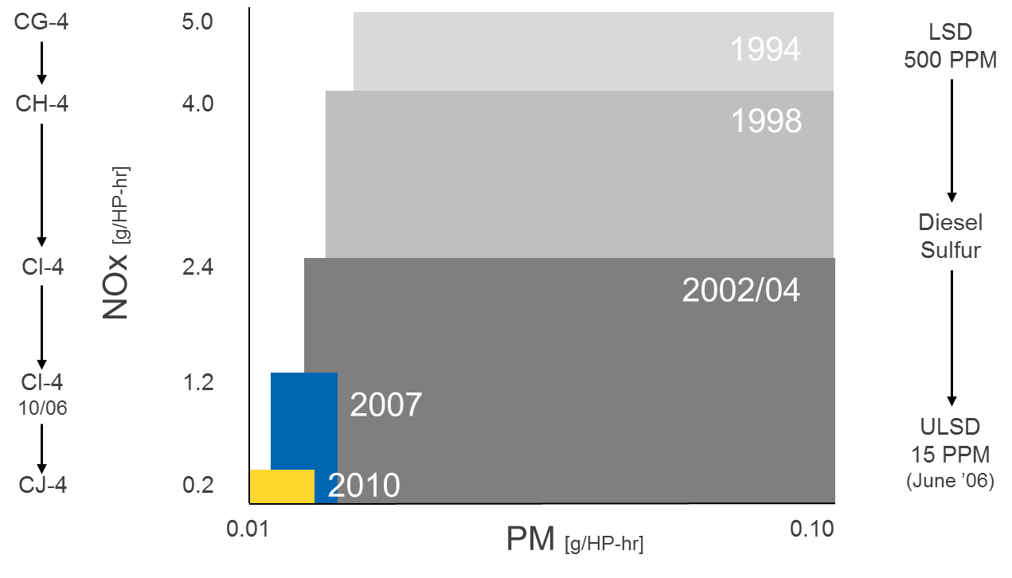
What are the Drivers of Evolving API Standards?
Historically, the main drivers to change the industry standards of Heavy Duty Engine Oils have been a call to reduce:
Particulate matter
NO_{x} emissions
These drivers played a key role in the development of previous PC-10 specification, which led to CJ-4.
But, now the focus has shifted to reducing CO₂ emissions.
Notes:
*ULSD – Ultra Low Sulfur content in Diesel

Slide 5
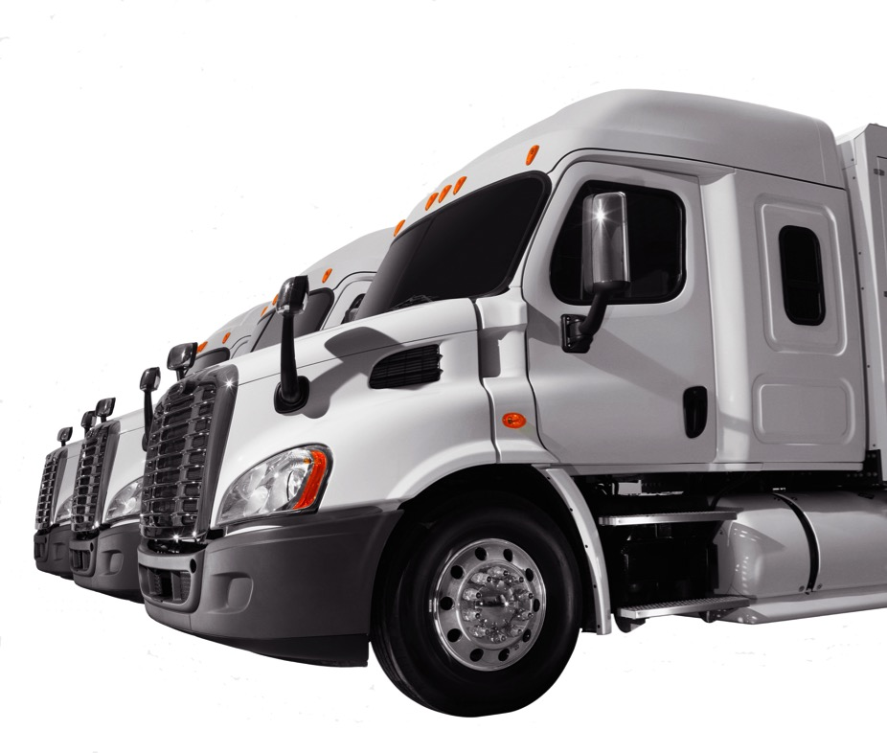
Industry standards are more demanding than ever before
News standards are calling for vehicle and engine improvements capable of:
Enhancing fuel efficiency
Helping fleets meet their aggressive sustainability-related goals
Further reducing CO₂ and greenhouse gas emissions

Slide 6
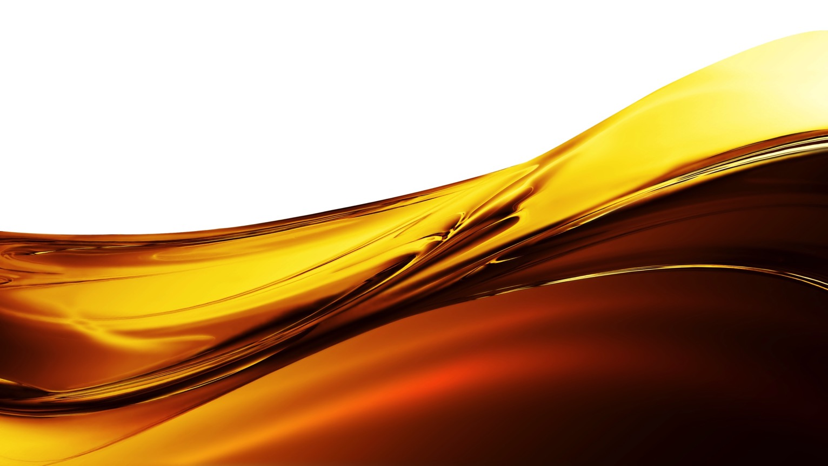
What is PC-11?
New heavy duty diesel engine oil category from American Petroleum Institute’s (API) set to go into effect December 1, 2016
PC-11 compliant oils will have to pass stringent tests and are designed to provide higher performance than today’s CJ-4 oils

Slide 7
Advancements in engine technology
Higher engine temperatures
Allow for better combustion in the cylinder and less after treatment (EGR in particular)
Tighter tolerances
Allow for increased fuel efficiency
Notes:
“The industry is moving to Higher engine temperatures. The higher temps allow for better combustion in the cylinder and less after treatment (EGR in particular). The down side to the higher engine temperatures is that it puts significant oxidative stress on the oil. (hence why PC-11 oil must have higher oxidation stability).
Higher tolerances in injectors?

Slide 8
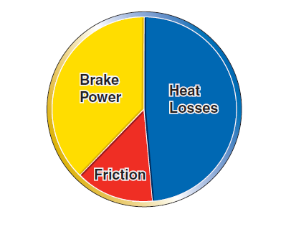
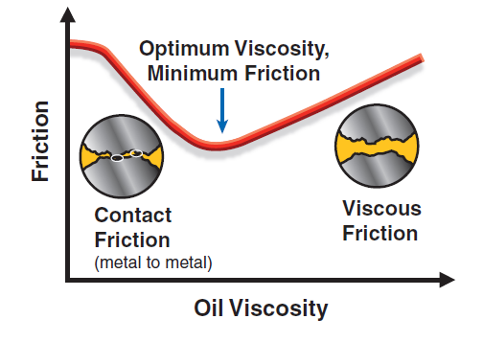
How Can Fuel Efficient Lubricants Impact Fuel Economy?
Fuel
  Fuel is a leading operating cost
  Only 35% of the fuel is used to move the truck
  The rest is lost as heat and friction
Two types of friction
  Viscous friction—Related to the thickness of the oil and includes energy losses related to pumping the oil through the engine
  Contact friction—Results from contact between metal surfaces; can lead to both engine wear and a reduction in fuel economy
Truck Movement: 35%
Heat: approx. 50%
Friction: 15%
Notes:
“The industry is moving to Higher engine temperatures. The higher temps allow for better combustion in the cylinder and less after treatment (EGR in particular). The down side to the higher engine temperatures is that it puts significant oxidative stress on the oil. (hence why PC-11 oil must have higher oxidation stability).
Higher tolerances in injectors?

Slide 9
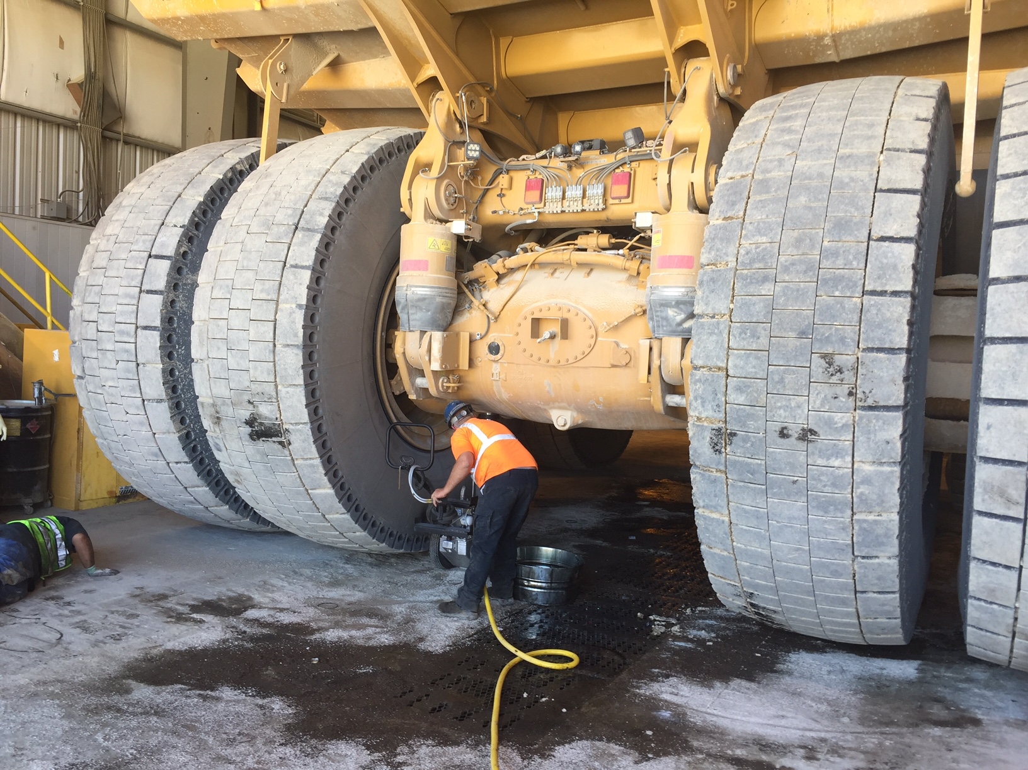


Energy Efficiency Study

Slide 10
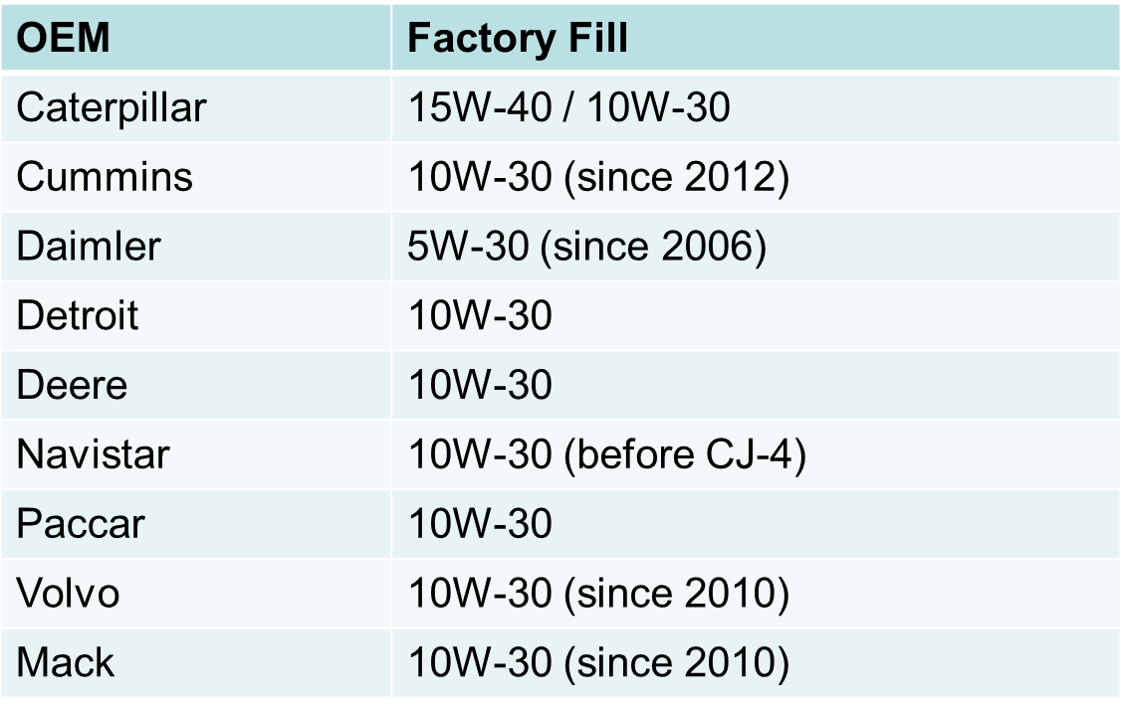
Current Factory Fill Oil

Slide 11
Comparing PC-11 oils with today’s CJ-4 oils

Slide 12
Performance benefits of PC-11 oils compared with CJ-4 oils
Superior Oxidation Stability
Enhanced Shear Stability
Improved Oil Aeration
Better engine performance and durability
Notes:
Compare against CJ-4

Slide 13
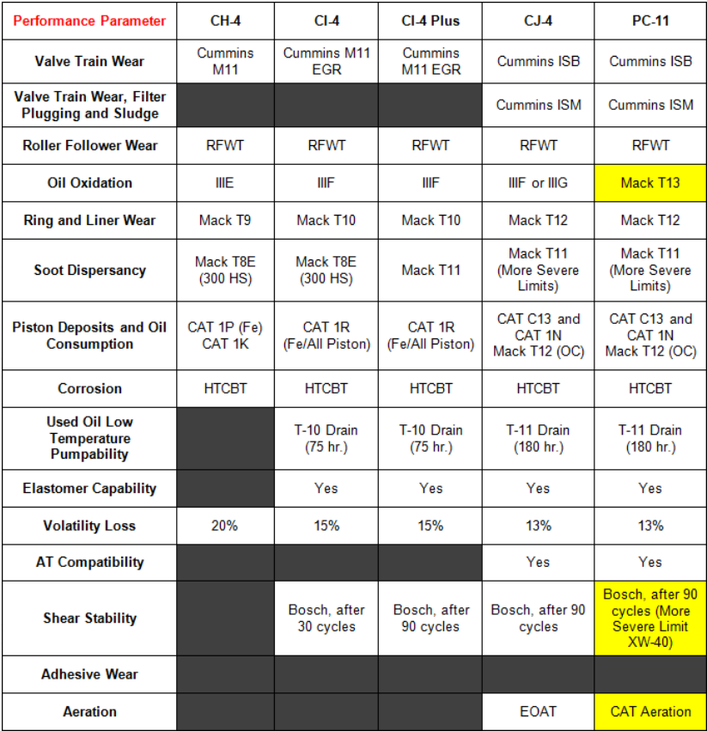
Notes:
“The industry is moving to Higher engine temperatures. The higher temps allow for better combustion in the cylinder and less after treatment (EGR in particular). The down side to the higher engine temperatures is that it puts significant oxidative stress on the oil. (hence why PC-11 oil must have higher oxidation stability).
Higher tolerances in injectors?

Slide 14

Oxidative stability benefits
Oxidation is the reaction of oil molecules with oxygen
New PC-11 oils will have to meet the requirements of the stringent Volvo T-13 oxidation test
Oxidation rates increase as engine and oil temperatures increase
Oxidation causes an oil to degrade, shortening its useful life
    Increased viscosity
    Acidic by-products
    Sludge/varnish formation
    Corrosive wear

Slide 15
Volvo T-13 oxidation test
The definitive performance test for PC-11, jointly developed by Volvo and ExxonMobil
Designed to age oil to ~50,000+ miles in 360 hours
Turbocharged 500 horsepower, Volvo eight cylinder engine equipped with EGR and running on ULSD. 1,500 RPM for 360 hours, at 130C (266F).
Volvo T-13 test criteria:
Peak IR oxidation level (360 hours)
Viscosity increase (final 60 hours)

Slide 16

Shear stability benefits
The shearing of polymers used in multigrade oils into smaller pieces can permanently reduce oil viscosity
  Reduced viscosity can leave critical engine parts vulnerable to serious wear
  Shearing can occur as the oil circulates through an engine and encounters gears, roller followers, piston rings, etc.
  In the past, soot thickening could compensate for shearing, but modern emission-controlled engines produce relatively little soot
CK-4 and FA-4 oils are more shear stable versus today’s CJ-4 oils

Slide 17

Reduced aeration benefits
Aeration is the introduction of tiny air bubbles into the oil
Aerated oil has diminished ability to cool and lubricate the engine
Aerated oil is more common in today’s emission-controlled engines due to higher operating temperatures and pressures
The Caterpillar Oil Aeration Test (COAT) measures an oil’s ability to release air trapped in the oil
The quicker the oil can release the air, the better
Less air in the oil will result in better lubrication and oxidative stability

Slide 18
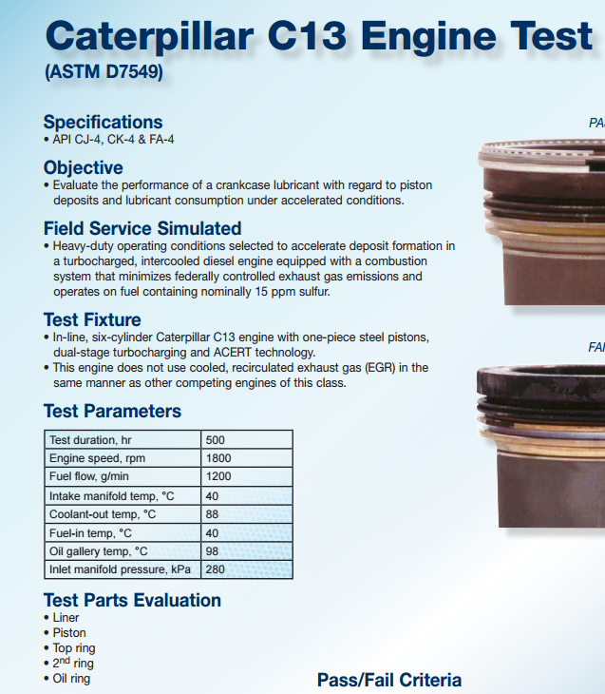
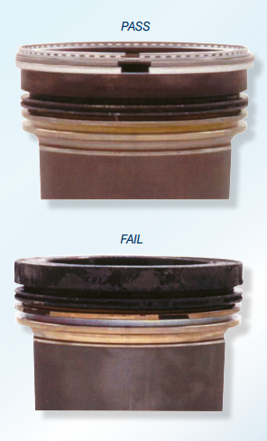


Slide 19
PC-11 is more than just one category change

Slide 20
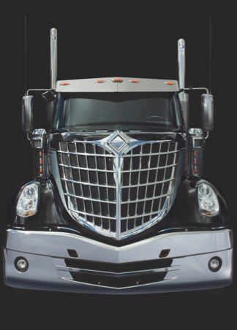
PC-11 will have two sub-categories
CK-4
Enhanced replacement for CJ-4 oils. Fully backwards compatible, and with traditional HTHS* viscosity
FA-4
Improved fuel economy, and lower HTHS* viscosity
*High temperature/high shear

Slide 21
Comparing CK-4 vs. FA-4 oils
While both new categories of PC-11 oils will deliver enhanced benefits over today’s CJ-4 oils, there are fundamental differences between the two categories, as noted below:
CK-4
FA-4
- Backwards compatibility not guaranteed – engine make/model specific
- Preferred for some 2017 model engines for enhanced fuel economy
- Lower HTHS viscosity between 2.9 and 3.2 cP @ 150C
- Only available in XXW-30 viscosity grade
- Backwards compatible to all engines operating on API CJ-4 oils today
- Direct replacement for current API CJ-4 oils
- Traditional HTHS viscosity of 3.5 cP @ 150C minimum
- Available in multiple viscosity grades - XXW-40, XXW-30

Slide 22
Understanding HTHS and its impact on fuel economy

Slide 23
What do you mean by High Temperature/High Sheer (HTHS)?
HTHS is the thin film viscosity measurement at high temperature and high sliding speeds such as those encountered in:
Oil pumps
Gearboxes
Valve trains
Piston rings
Piston liner interfaces
The viscosity contribution of multigrade additive is minimized due to the high shear force
Resulting HTHS viscosity measurement is primarily that of the base oil component alone
Multigrade Additive - Polymer Contribution
Apparent
Viscosity
Base Oil Viscosity
Shear Rate

Slide 24
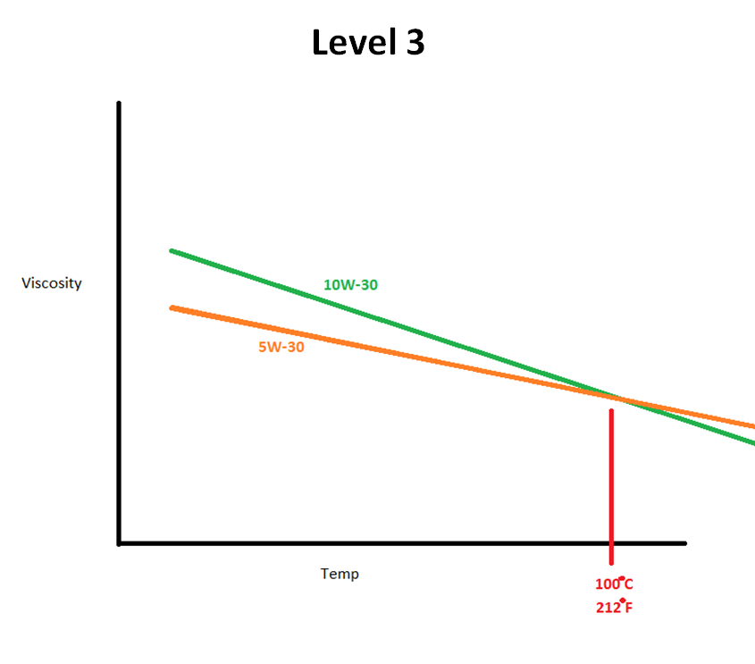
White Board Discussion
Level 1 – Multi-Viscosity Oil
Level 2 – Base Stock vs VI Improver
Level 3 – 5W-30 vs 10W-30
Level 4 – Low Temp and HTHS
Ilistrations are for general reference only and do not represent all oils in the in the API viscosity categories

Slide 25
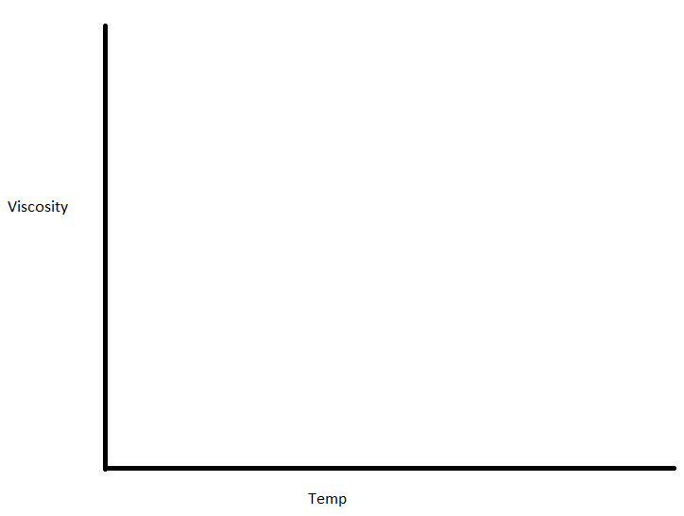
Level 1

Slide 26
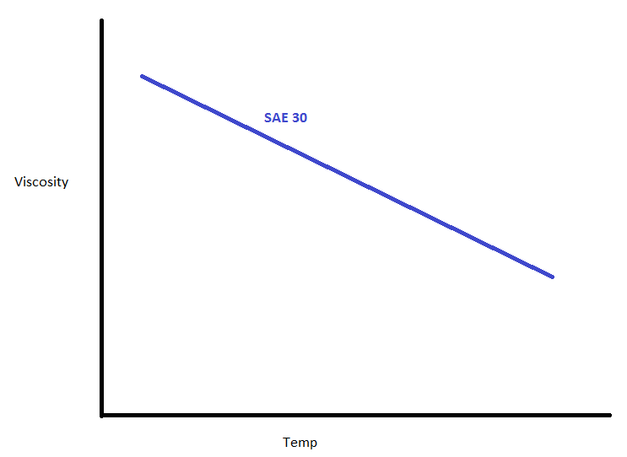
Level 1

Slide 27
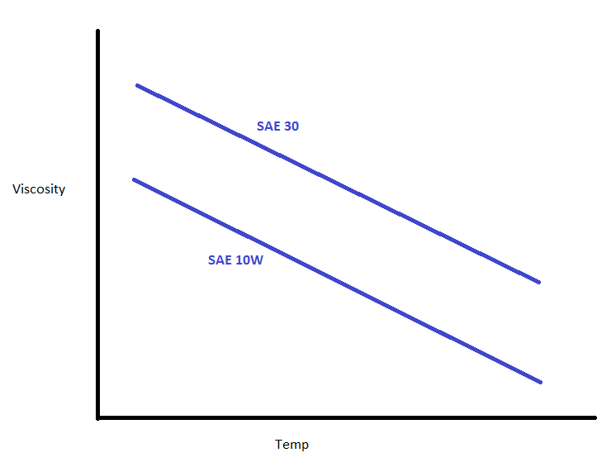
Level 1

Slide 28
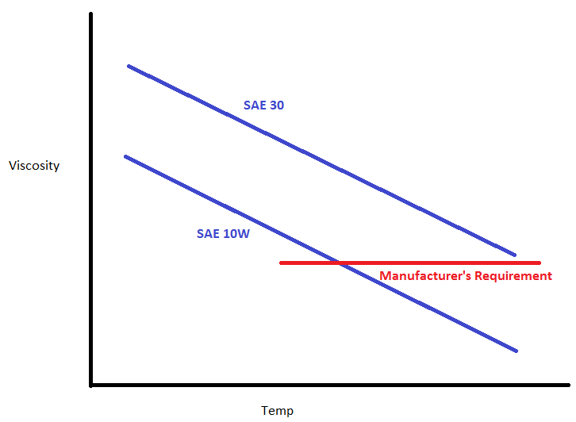
Level 1

Slide 29
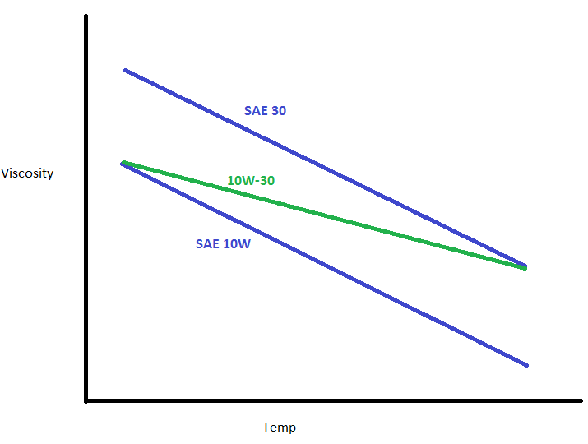
Level 1

Slide 30
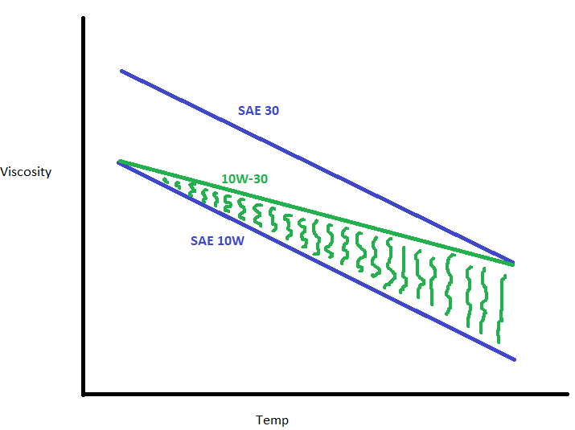
Level 1

Slide 31
Level 2

Slide 32
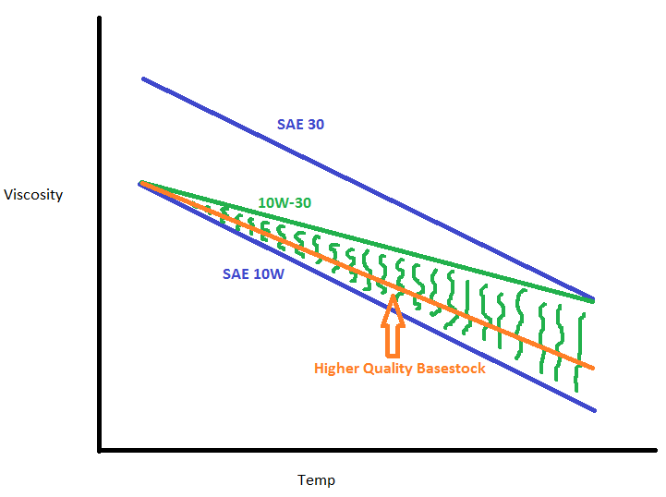
Level 2

Slide 33
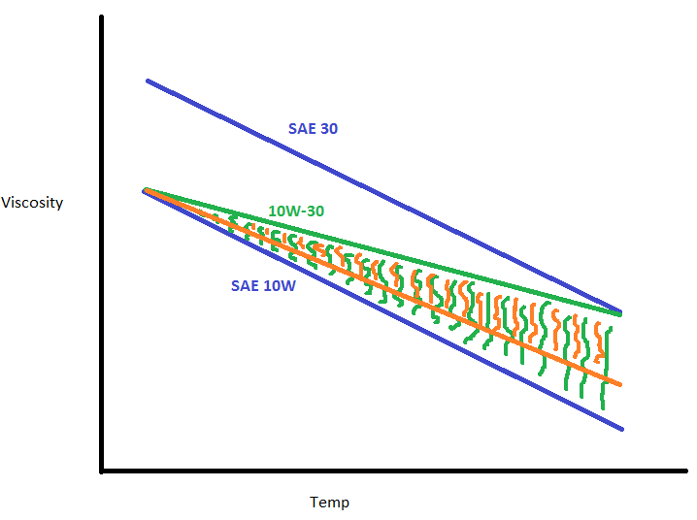
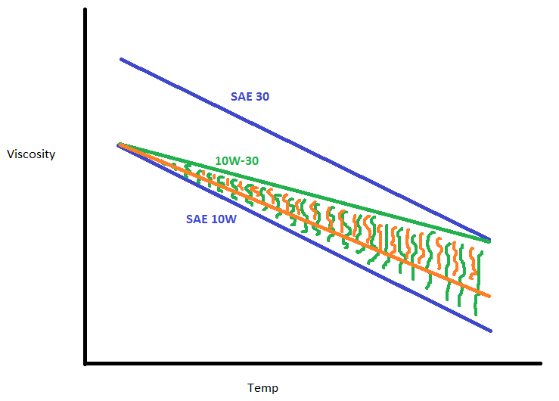
Level 2

Slide 34
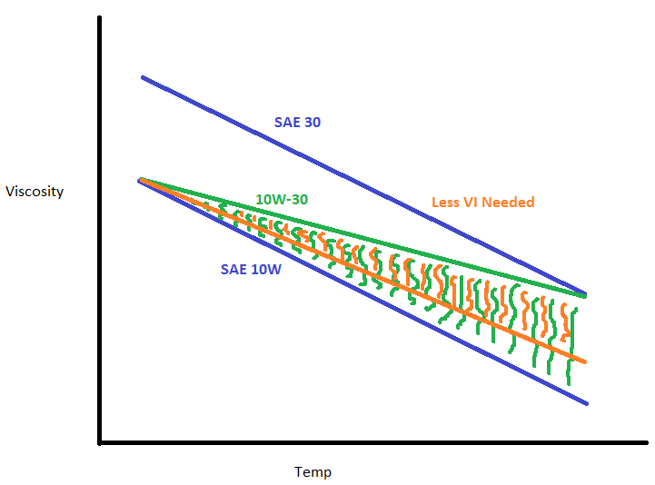
Level 2

Slide 35
Level 3

Slide 36
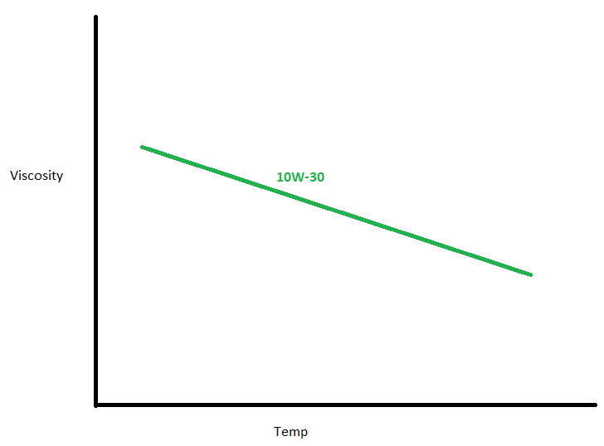
Level 3

Slide 37
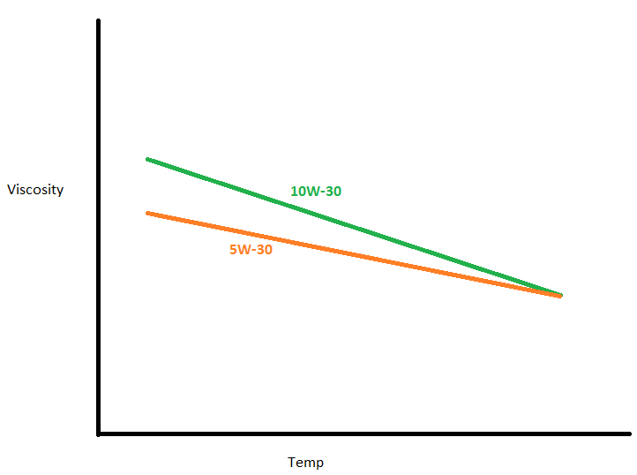
Level 3

Slide 38
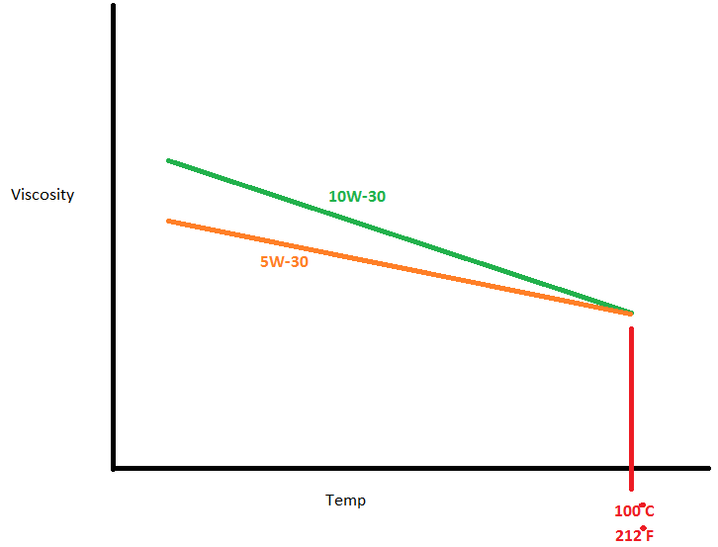
Level 3

Slide 39
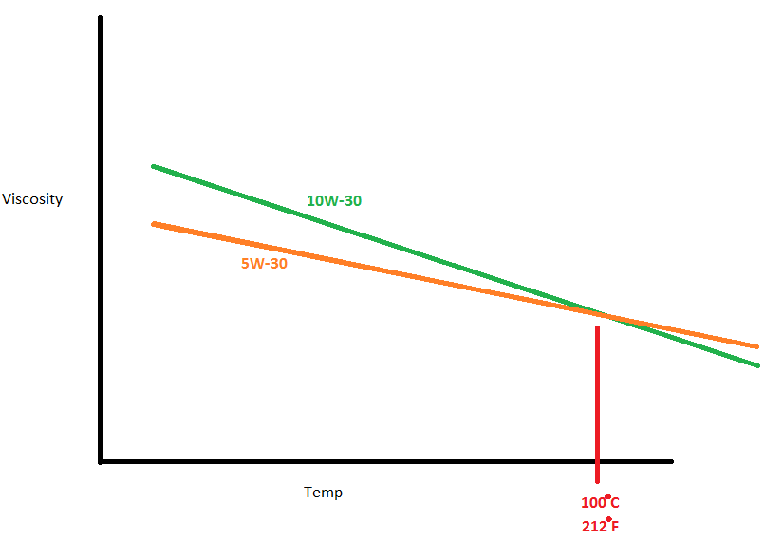
Level 3

Slide 40
Level 4

Slide 41
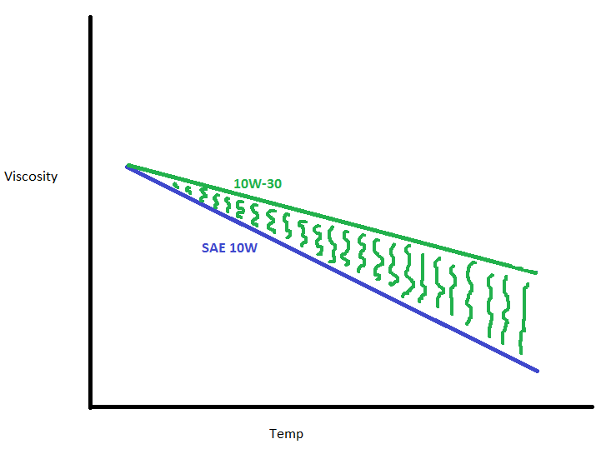
Level 4

Slide 42
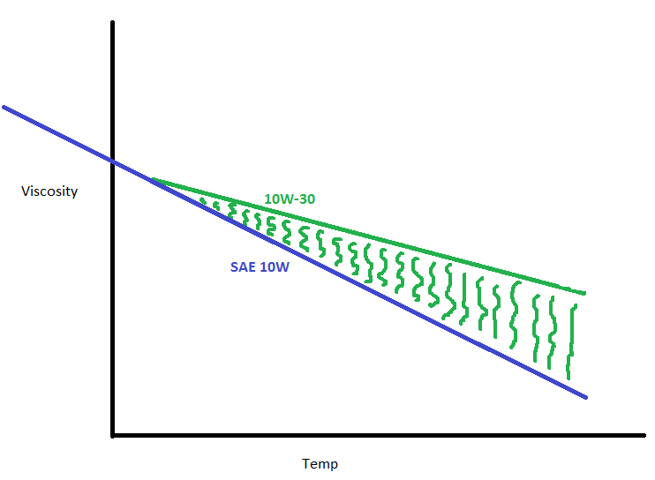
Level 4

Slide 43
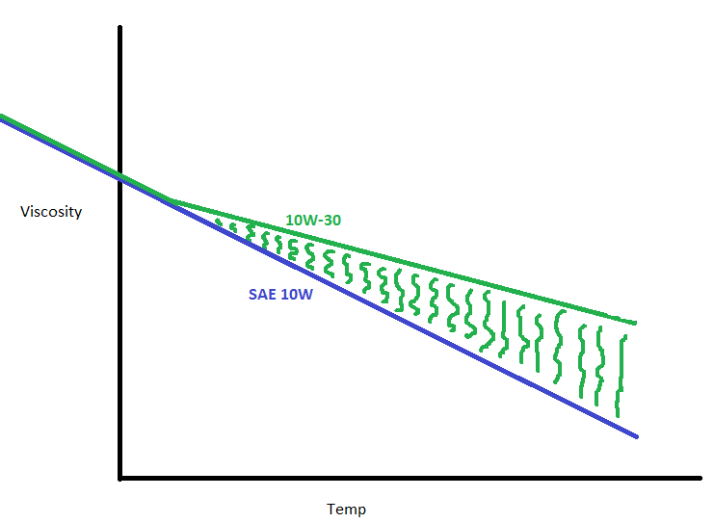
Level 4

Slide 44
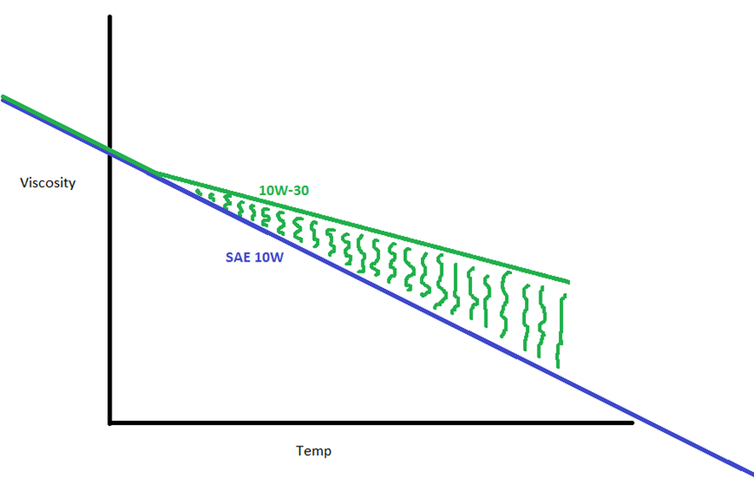
Level 4

Slide 45
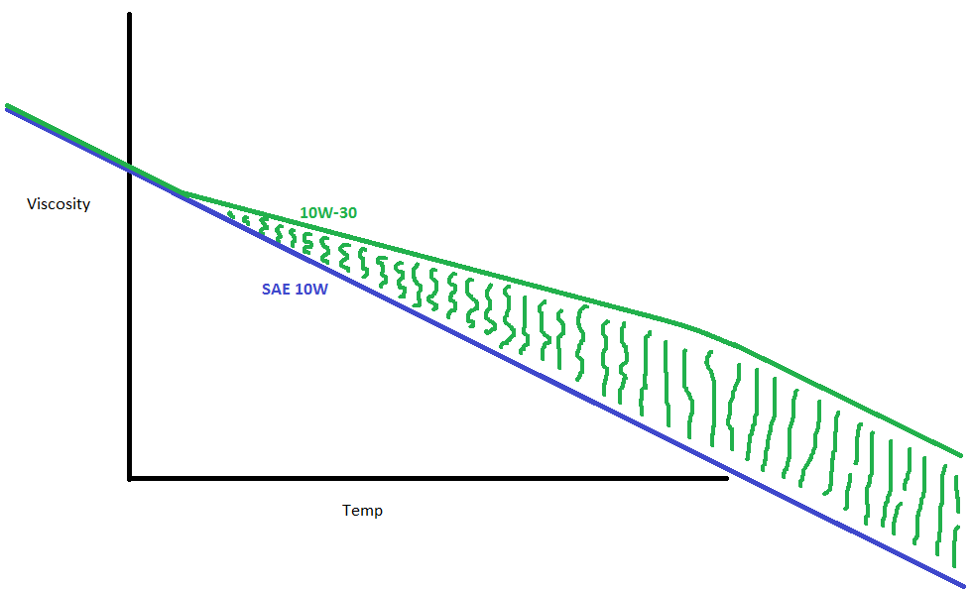
Level 4

Slide 46
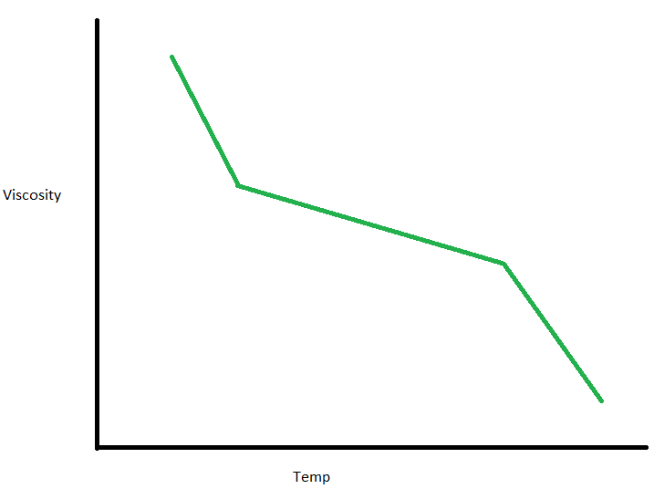
Level 4

Slide 47
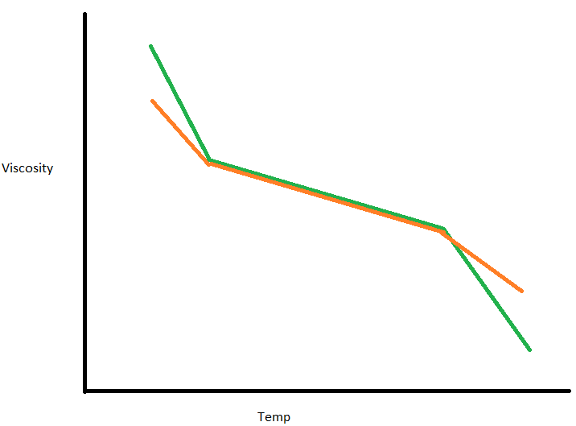
Level 4

Slide 48
FA-4 oils will have lower HTHS limit, which can help improve fuel economy potential
SAE 20
SAE 30
SAE 40/50
Today’s API CJ-4 15W-40 oils are the baseline for comparison.
Notes:
Update chart per Thomas email

Slide 49
Lower HTHS limits of FA-4 oils can help improve fuel economy potential over today’s CJ-4 oils
SAE 20
SAE 30
SAE 40/50
The new API FA-4 10W-30 oils could provide an approximate 1% improvement in fuel economy vs. today’s 15W-40 baseline

Slide 50
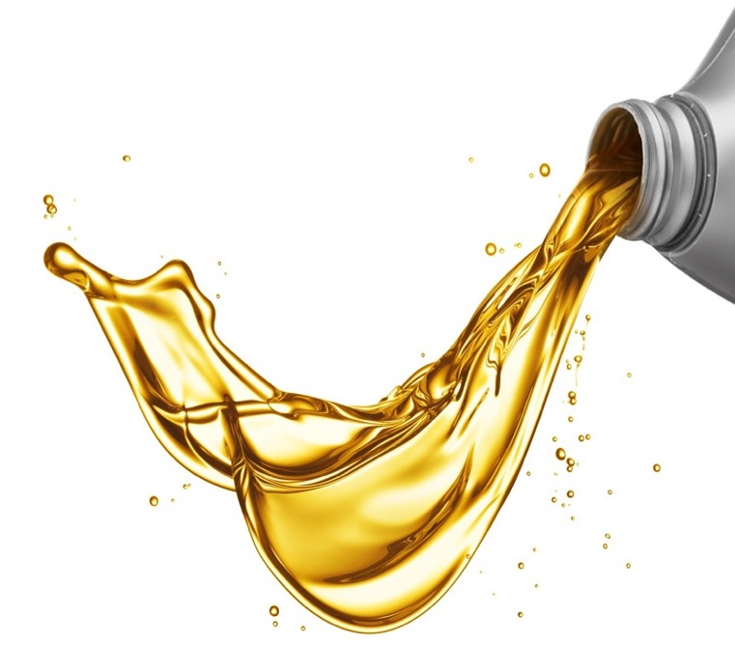
The difference in 10W-30 formulations
Both CK-4 and FA-4 categories will have 10W-30 formulations
But lower high temperature/high shear FA-4 10W-30 oils will provide greater fuel economy potential than CK-4 10W-30s
FA-4
10W-30
CK-4
Better fuel economy
10W-30
CK-4
15W-40

Slide 51

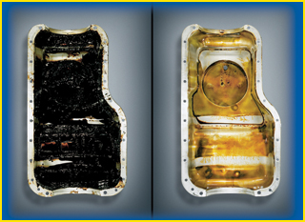
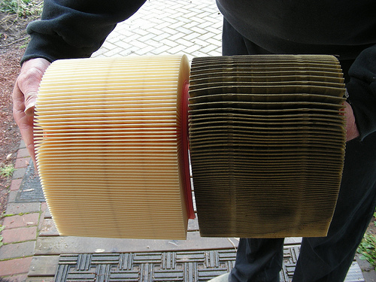
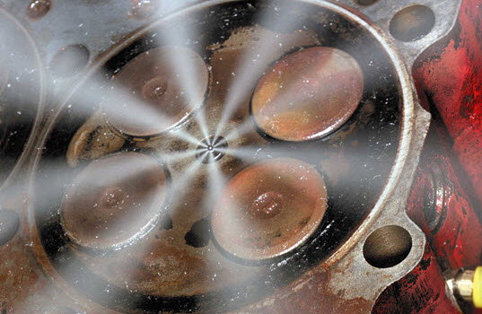
Drain Limitations

Slide 52
Summary

Slide 53
Summary
Launch date – Dec 1, 2016
CK-4 is an improvement to CJ-4
    Oxidation
    Aeration
    Sheer stability
    Backwards compatible
  FA-4 is chosen by the OEM
    Not backwards compatible
    Even better fuel economy
Action Items
  Follow OEM Recommendations
  Consider Consolidation with Manufacturer Support

Slide 54
Thank you

Slide 55
Backup - Ford
Ford has tested low phosphorus (800ppm) CK-4 oil that produced wear in the valve train of their 6.7L Super Duty diesel engine
Ford did not experience this issue with CJ-4 oils (with minimal actual data)
This problem is unique to Ford; no other OEM’s have had similar issues with CK-4 oils
Ford’s new specification, WSS-M2C171-F1, will require passing their valve train wear test for oil qualification
  This test does not exist today and the passing parameters are unknown
  This test will not be available until 2Q17 at the earliest
In the meantime, Ford will allow existing CJ-4 oils (not claiming CK-4) to be used in Ford engines without WSS-M2C171-F1 on the label.
CK-4 oils, based on formulations licensed for CJ-4 before January 2016, with greater than 1000 ppm phosphorus, can gain the approval without needing to pass the valve train wear test until the test is available

